Slide 1
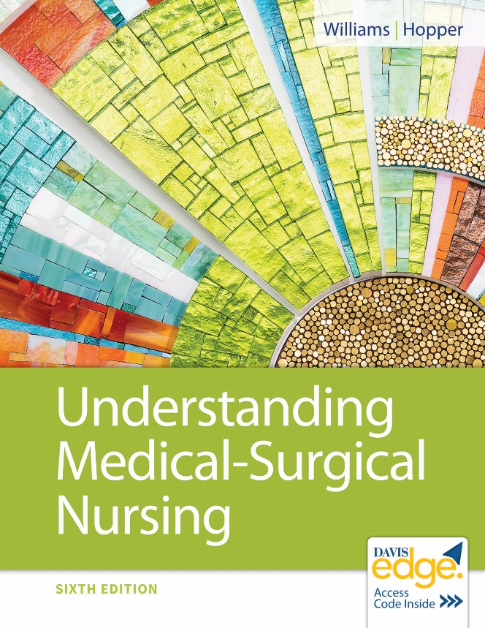
Chapter 18
Immune System Function, Assessment, and Therapeutic Measures

Slide 2
Learning Objectives
Identify the type of immunity that is obtained with a vaccine.
Describe the two mechanisms of immunity.
Discuss the function of each class of immunoglobulin and how each behaves in a particular immune response.
Describe how aging affects the immune system.

Slide 3
Learning Objectives (continued)
Explain subjective data that are collected when caring for a patient with a disorder of the immune system.
Explain objective data that are collected when caring for a patient with a disorder of the immune system.
Describe nursing care provided for patients undergoing diagnostic tests for the immune system.
Discuss common therapeutic measures used for disorders of the immune system.

Slide 4
Immune System
Lymphoid organs
Lymphocytes and white blood cells
Chemicals
Lymphatic system
Lymphatic vessels, lymph nodes, spleen

Slide 5
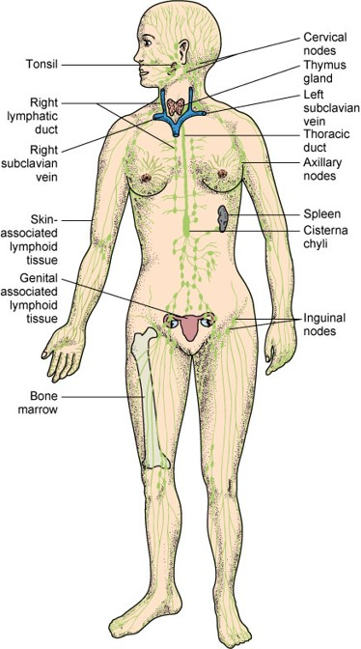
Immune System (continued)

Slide 6
Antigens
Chemical markers that identify cells
Human cells have “self” antigens
Foreign cell antigens will not match
Recognized as foreign and destroyed

Slide 7
Lymphocytes
Natural killer cells
Thymus-derived lymphocytes (T cells)
Bone marrow-derived lymphocytes (B cells)
Natural killer cells
Blood, bone marrow, lymph nodes, spleen
Destroy pathogens and tumor cells

Slide 8
Lymphocytes (continued)
T cells and B cells
Each cell responds to one foreign antigen.
T cells
Lymph nodes and nodules, spleen
B cells
Plasma cells produce antibodies to specific foreign antigen.
Memory cells

Slide 9
Antibodies
Immunoglobulins (I g) or gamma globulins
Proteins produced by plasma cells in response to foreign antigens
Specific for only one antigen
Label antigens for destruction
Five classes of human antibodies
I g G, I g A, I g M, I g D, I g E

Slide 10
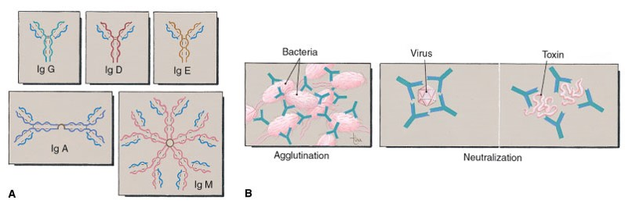
Antibodies (continued)

Slide 11
Two Mechanisms of Immunity
Cell-mediated immunity
Humoral immunity

Slide 12
Cellular Immunity

Slide 13
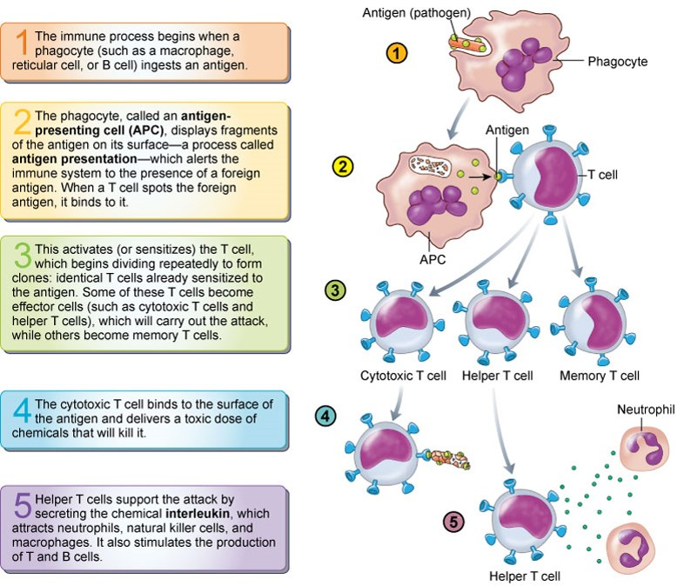
Humoral Immunity

Slide 14
Mechanisms of Immunity
Cell-mediated immunity
Recognition of foreign antigen by helper T cells (C D4)
Killer T cells lyse cells (C D8)
Memory T cells remember specific foreign antigens
Suppressor T cells limit immune response

Slide 15
Mechanisms of Immunity (continued_1)
Humoral immunity
Antibody-mediated immunity recognition of antigen as foreign
B cells proliferate and differentiate
Plasma cells producing antibodies that circulate forming an antigen-antibody complex
Memory B cells
Antibodies label antigen for phagocytosis

Slide 16
Mechanisms of Immunity (continued_2)
Antigen-antibody complex stimulates complement fixation
Enzyme complex lyses cells
Labels foreign antigens for phagocytosis

Slide 17
Antibody Responses
First exposure to foreign antigen stimulates antibody production in small amounts.
Second exposure to antigen causes memory cells to make large amounts of antibody.
Vaccines based on this principle
Allergic responses when antibodies respond to foreign but harmless antigens

Slide 18
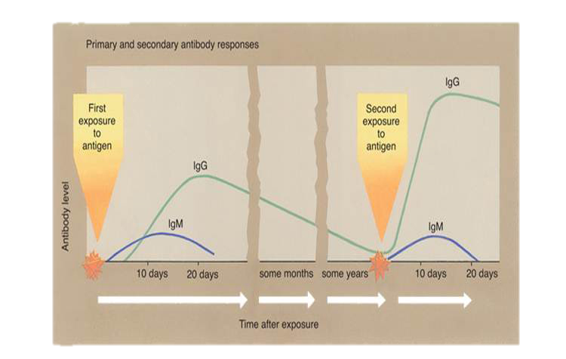
Antibody Responses (continued)

Slide 19
Types of Immunity
Passive immunity
Antibodies obtained outside person
Temporary
Naturally acquired
Placental transmission of antibodies
Antibodies in breast milk
Artificially acquired
Injection of preformed antibodies

Slide 20
Types of Immunity (continued)
Active immunity
Produces own antibodies
Naturally acquired
Recover from disease, memory cells specific for that pathogen
Artificially acquired
Vaccine
Stimulates production of antibodies and memory cells
Some confer lifelong immunity

Slide 21
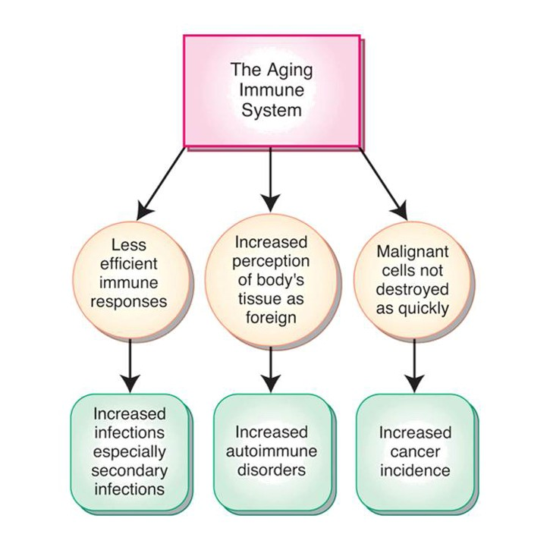
Aging and the Immune System

Slide 22
Aging and the Immune System (continued_1)
Thymus gland size decreases
Increased production of immature T cells
Decreased antibody response

Slide 23
Aging and the Immune System (continued_2)
Microbiota
Collection or community of microbes
Essential for immune function
Onging research for understanding
Disruption possible factor in disease development
Cardiovascular disease, irritable bowel syndrome, immune disorders (lupus, rheumatoid arthritis)

Slide 24
Immune System Assessment
Subjective data
Demographic data
Health history
Objective data
Physical examination

Slide 25
Diagnostic Tests
Blood tests
Radiographic tests
Biopsy
Skin tests
Gene testing

Slide 26
Therapeutic Interventions
Allergies
Medical I D
Ask if allergies
Anaphylaxis
Antihistamines
Epinephrine autoinjector
Always have
Check expiration date

Slide 27
Therapeutic Interventions (continued_1)
Immunotherapy
Desensitize person with anaphylactic reactions or with chronic allergic symptoms.
Inject small amounts of extract of allergen until hyposensitivity reached.
Recognize anaphylactic reaction can occur.

Slide 28
Therapeutic Interventions (continued_2)
Medications
Antibiotics
Antihistamines
Antivirals
Corticosteroids
Decongestants
Epinephrine
Histamine H₂ blockers
Hormone therapy
Immunosuppressants
Interferon
Leukotriene antagonists
Mast cell stabilizing drugs

Slide 29
Therapeutic Interventions (continued_3)
Surgical management
Splenectomy
Monoclonal antibodies
Recombinant D N A technology

Slide 30
Review Question
Antibodies recognized as foreign by the immune system are destroyed.
True
False

Slide 31
Review Question Answer
Correct Answer: 2
False, antigens are destroyed.

Slide 32
Review Question (continued_1)
Which of these is one of the classes of human antibodies? Select all that apply.
Immunoglobulin (I g)G
White blood cells
Red blood cells
I g D
I g E

Slide 33
Review Question Answer (continued_1)
Correct Answer: 1, 4, 5

Slide 34
Review Question (continued_2)
An allergic response occurs when antibodies respond to foreign but harmless antigens.
True
False

Slide 35
Review Question Answer (continued_2)
Correct Answer: 1

Slide 36
Review Question (continued_3)
Which of these would the nurse reinforce to a patient who received vaccine education? Select all that apply.
Provides artificially acquired immunity
Stimulates production of small amounts of antibodies
Stimulates production of memory cells
Provides naturally acquired immunity
Provides temporary immunity

Slide 37
Review Question Answer (continued_3)
Correct Answer: 1, 2, 3

Slide 38
Review Question (continued_4)
The nurse contributes to the teaching plan of a patient who is allergic to peanuts by including that it is MOST important for the patient to carry which of the following?
Diphenhydramine (Benadryl)
Epinephrine autoinjector
Tourniquet
Naloxone (Narcan)

Slide 39
Review Question Answer (continued_4)
Correct Answer: 2

